Slide 1



Geospatial Track
Capstone Community Discussion
George Percivall, IEEE GRSS and Spatial Web
Geospatial and Remote Sensing Track
Tuesday, October 4, 2022

Slide 2
Geospatial Track
Capstone Discussion with Community
Quick summary of geospatial in Apache
  Past ApacheCon geospatial tracks
  Updates on geospatial projects not briefed today
Community Discussion
  Synthesize common themes from sessions of geospatial tracks
  Develop recommendations on coordinated activities to advance Apache Projects

Slide 3
ApacheCon Geospatial Tracks
ApacheCon Geospatial and Remote Sensing track highlights use of Apache projects for geospatial data and services
Vancouver 2016
Madrid 2016
Montreal 2018
Las Vegas 2019
@Home 2020
Virtual 2021
New Orleans 2022
geospatial@apache.org

Slide 4
Apache: Big Data – geospatial track
Vancouver 2016
Open Geospatial Standards and Open Source - George Percivall, Open Geospatial Consortium
Geospatial Analytics Using Apache Spark Running on Apache Mesos - Adam Mollenkopf, Esri
SciSpark: MapReduce in Atmospheric Sciences - Kim Whitehall, NASA Jet Propulsion Laboratory
Geospatially Enable Hadoop, Accumulo, and Spark with LocationTech Projects, Robert Emanuele
Hiding Some of Geospatial Complexity - Martin Desruisseaux, Geomatys
Geospatial Querying in Apache Marmotta - Sergio Fernandez, Redlink GmbH
Spatial Data to Support Precision Urban Planning - Yonghua Zeng, IBM
Crowd Learning for Indoor Positioning - Thomas Burgess, indoo.rs

Slide 5
Apache: Big Data – geospatial track madrid 2016
Apache SIS for Earth Observation and Beyond - Martin Desruisseaux, Geomatys
Geospatial Big Data: Software Architectures and the Role of APIs in Standardized Environments - Ingo Simonis, Open Geospatial Consortium (OGC)
Geospatial Track: Crowd Learning for Indoor Navigation - Thomas Burgess, indoo.rs GmbH
Processing Planetary Sized Datasets - Tim Park, Microsoft

Slide 6
Apachecon – geospatial track
Montreal 2018
Which geospatial API for the cloud? Apache SIS : Martin Desruisseaux
Spatial query on vanilla databases with Apache Calcite : Julian Hyde
Spatial index optimization using Apache Lucene and GIS query support: Jinchul Kim, Navis
Interacting with Billions of National Water Model (NWM) Predictions using Apache Kafka and MapD: Aaron Williams, Ben Lewis
Apache Spark MLib applied to geospatial imagery for flood indication: Tom Landry
Introducing Apache SDAP (Incubating): An Integrated Data Analytic Center for Big Science Problems: Lewis McGibbney
Geospatial data and processing in Apache projects: George Percivall

Slide 7
Apachecon – geospatial track
Las Vegas 2019
Geospatial Data and Processing - Reusable Building Blocks - George Percivall, OGC
Geospatial Data Management in Apache Spark - Jia Yu, ASU & Mohamed Sarwat, ASU
Apache Science Data Analytics Platform Apache (SDAP) - Thomas Huang, JPL
Using GeoMesa on top of Accumulo, HBase, Cassandra, and big data file formats for massive geospatial data - a LocationTech Project - James Hughes, CCRI & Eddie Pickle, Radiant Solutions
Geospatial Indexing and Search at Scale with Apache Lucene - Nick Knize, Elastic
GeoSpatial and Temporal Forecasting in Uber Marketplace - Chong Sun, Uber and Brian Tang, Uber
Realtime Geospatial Analytics with GPUs, RAPIDS, and Apache Arrow - Josh Patterson, NVIDIA

Slide 8
ApacheCon – Geospatial Track
@Home 2020 (1 of 2)
Apache Geospatial: Open Source and Open Standards: George Percivall
Visualize Apache SIS capabilities with raster data: Martin Desruisseaux
pygeoapi: an OSGeo community project implementing OGC API standards – Tom Kralidis, Francesco Bartoli
Enabling geospatial in big data lakes and databases with LocationTech GeoMesa – James Hughes
Map Serving with Apache HTTPD Tile Server Ecosystem (AHTSE) – Lucian Plesea

Slide 9
ApacheCon – Geospatial Track
@Home 2020 (2 of 2)
Apache Spark Accelerated Deep Learning Inference for Large Scale Satellite Image Analytics – Dalton Lunga
AutoRetrain: automated deep learning model training on imagery using Apache Airflow and Apache Nifi - Carlos Caceres
GeoSpark: Manage Big Geospatial Data in Apache Spark – Jia Yu, Mohamed Sarwat
Rethinking Earth Observation using Deep Learning – Sayantan Das
Bring Satellite and Drone Imagery into your Data Science Workflows – Jason Brown
Massively Scalable Real-time Geospatial Anomaly Detection with Apache Kafka and Cassandra - Paul Brebner

Slide 10
ApacheCon geospatial track
Virtual 2021
Apache SIS and other projects: Martin Desruisseaux
OGC API – Processes: Benjamin Pross
Rasdaman Datacubes: Peter Bauman
GeoSPARQL with Apache Jena: Marco Neumann
Apache Sedona (incubating): Paweł Kociński
Streaming Geospatial Vectors with Apache Projects: Jim Hughes
Tile Server Ecosystem using Apache HTTPD: Lucian Plesea

Slide 11
APACHECON Geospatial TRACK
New Orleans 2022
Apache Science Data Analytics Platform (SDAP), Stepheny Perez
Geospatial Search with Apache Lucene, Nick Knize
Understanding and Streaming Geospatial Vector Data using Apache Kafka and GeoMesa, Jim Hughes and Austin Heyne
Real-time analytics over Geospatial data at Uber scale with Apache Pinot, Yupeng Fu
Enabling scalable modern GIS with GeoParquet, Matthew Forrest
Geospatial Track Capstone Discussion with Community, George Percivall
Co-chairs: Jim Hughes and George Percivall - Apache Members

Slide 12
Apache Projects with Geo brief update on projects not presented today

Slide 13

Apache Spatial Information System (SIS)
Apache SIS provides data structures for geographic features and associated metadata along with methods to manipulate those data structures
Current release is 1.2 (May 2022) — sis.apache.org
Implementation of OGC GeoAPI 3.0.1 — www.geoapi.org
Focus on OGC/ISO standards (~15 of them)
  Metadata, referencing, features, coverage, filter
Increasing list of supported formats (some read-only)
  WKT, GML for referencing, GPX, CSV for Moving Features, netCDF, GeoTIFF, World File, ASCII Grid, BIL/BIP/BSQ…
Can read from Amazon S3 storage
Multi-threaded operations on coverage
  raster reprojection, isoline generation
Small JavaFX application for demonstration
Coming for 1.3 release:
  Bug fixes (GeoTIFF, isolines, JavaFX application…), better handling of wraparound (±180°) in map projections, data cube and more.
Martin Desruisseaux. martin.desruisseaux@geomatys.com

Slide 14
Apache Jena and Geosparql
Apahce Jena: best support for OGC GeoSPARQL
  Old Apache Jena spatial module now removed from main codebase in favor of the Apache Jena GeoSPARQL module.
  Apache Jena GeoSPARQL module has reached a level in which further manpower would be needed to make major progress.
Ongoing discussions about GeoSPARQL revision
  Apache Jena GeoSPARQL already surpasses current GeoSPARQL spec with feature support
  Wider discussion about GeoSpatial Semantic Web can not be exclusively addressed by a software project like Apache Jena
Raster support for Apache Jena GeoSPARQL as a user contribution
  Not in the main Apache Jena GeoSPARQL module and not part of the OGC GeoSPARQL spec. (https://github.com/i3mainz/jena-geo )
Jena at 4.6.1 (September 2022)
GeoSPARQL: GML handling.
  Change to GeoSPARQL to enable interoperation with GML data sources.
  The change impacts impacts existing data and any spatial indexes would
  will need to be deleted and rebuilt. at 4.6.0 (August 2022)
GeoSPARQL: GML handling.
  GH-1299 - The GeoSPARQL has acknowledged a mistake in their documentation whereby the wrong namespace was being used for "gml:".
  https://github.com/opengeospatial/ogc-geosparql/pull/334
  This also leads to problems with interoperation with GML data sources.
  Unfortunately the change impacts impacts existing data and any spatial indexes would will need to be deleted and rebuilt.
  https://github.com/apache/jena/issues/1299
  at 4.4.0 (Feb 2022)
Assembler for GeoSPARQL
  This makes it easier to use GeoPSARQL in a plain Fuseki.
  https://jena.apache.org/documentation/geosparql/geosparql-assembler.html
update from Marco Neumann

Slide 15


Geospatial support in Apache Calcite
Calcite
Dynamic data management framework
Components necessary to build a DBMS (SQL parser and semantic analyzer, relational algebra, optimizer engine, custom functions and adapters, JDBC/ODBC driver)
Implemented in Java and easy to embed
Full SQL implementation
Geospatial
GEOMETRY data type and over 180 built-in spatial functions
Functions implemented in Java using JTS and proj4j (ESRI until Calcite release 1.31)
Spatial indexing without specialized data structures:
Add a column with space-filling curve index, or
Populate a table of tiled geometries, and
Calcite rewrites queries to use them
https://calcite.apache.org @ApacheCalcite
Slide prepared by: Julian Hyde

Slide 16
Slide from Felix Cheung, Safegraph

Slide 17
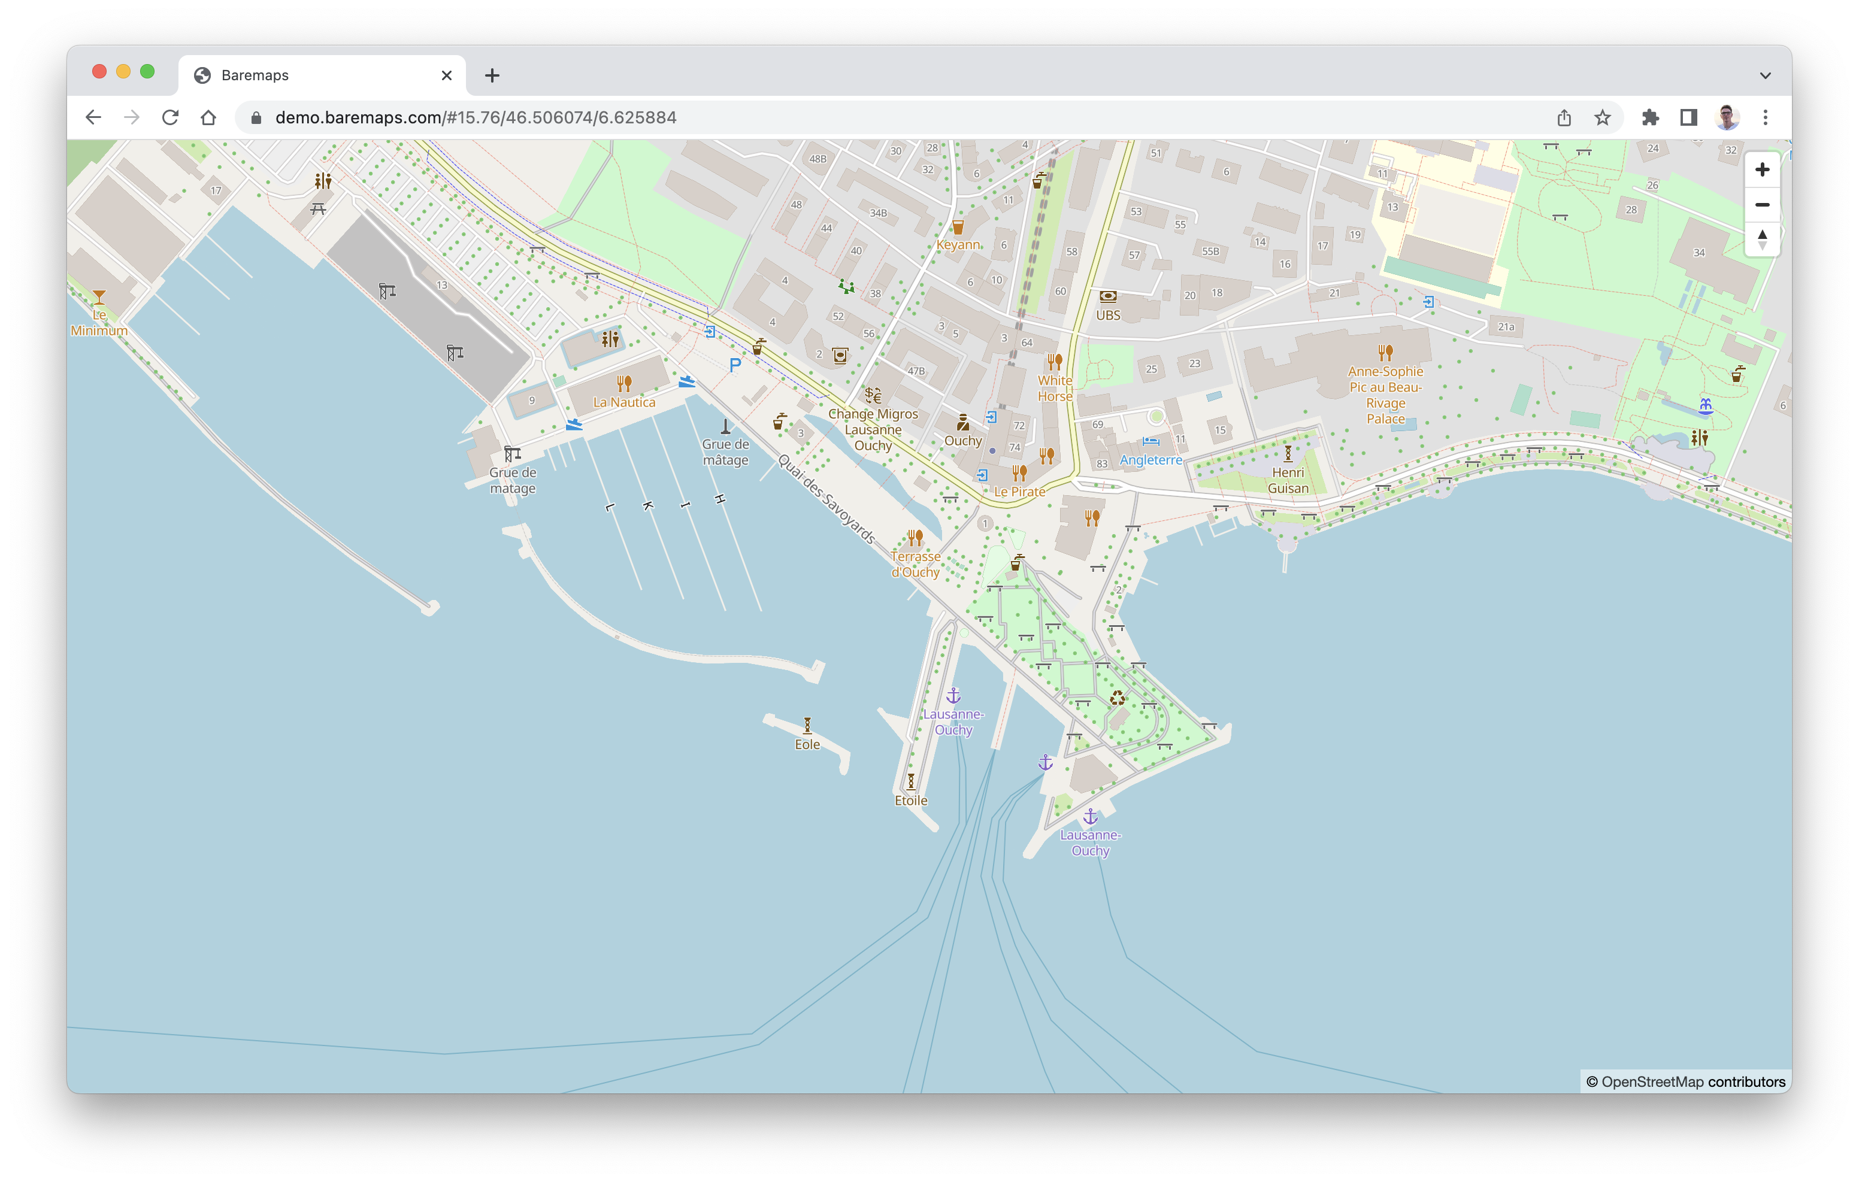

🗺 Baremaps (Proposed to the Apache Incubator)
Web Mapping Infrastructure for the rest of us
✅ Vector tile pipeline
✅ Tile server with live reload
✅ CC0 schema and style
🚧 IP to location
🚧 Geocoding
🚧 Reverse geocoding
🚀 And more…
🫵 We need you
Bertil Chapuis. bchapuis@gmail.com

Slide 18

OGC API Sprints
Joint OGC-OSGeo-Apache Code Sprint
  March 2022
  Focus on running code from OSGeo and Apache Software Foundation
Space Partitions Code Sprint
  May 2022
  OGC API - DGGS, - Tiles, - Coverages and - EDR
Vector Data Code Sprint
  July 2022
  OGC API - Features, - Moving Features, - Routes and - 3D GeoVolumes
Metadata Code Sprint (joint with ISO / TC 211)
  going on now in Singapore
  OGC API – Records, STAC, ISO 19115, JSON-FG
Maps Code Sprint
  29 November – 1 December in Brussels, Belgium
  OGC API - Maps, - Tiles, - Styles

Slide 19

Best Practices for Spatial Data
Make data available through APIs
Use spatial data encodings that match your target audience
Link resources together to create the Web of data
Spatial analytics - discover meaningful patterns in spatial data
Provide geometries in a usable way: right level of accuracy, precision, size
Choose coordinate reference systems to suit your user’s applications
OGC/W3C Spatial Data on the Web Best Practices https://www.w3.org/TR/sdw-bp/

Slide 20
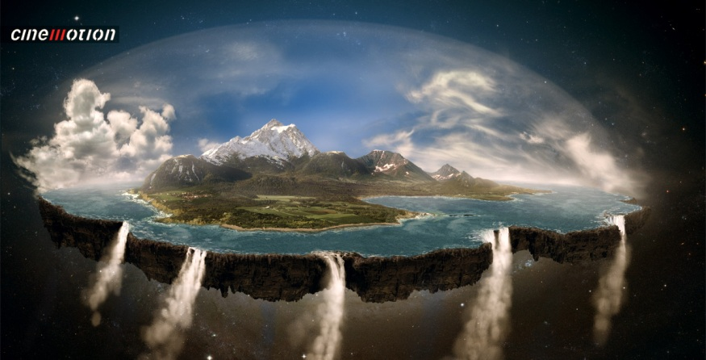
In the beginning…
All was simple, everyone agreed: the world was flat.

Slide 21
Apache Geospatial: Discussion
How to make geo easy and accurate?
Opportunities for coordination and reuse between Apache Projects?
Coordination of Apache with other open-source Geo communities?
Open Source and Open Standards: OGC, ISO, IEEE
How to address the growing availability of geo data, in particular remote sensing?
Moving from 3D/4D to hyperspatial
(your topic)
geospatial@apache.org

