Slide 1
Roadmap for Fineract
Honing in on a Limitless Horizon

Slide 2
Agenda
Overview/Objectives
Roadmap
Processes
Call to Action & Next Steps

Slide 3
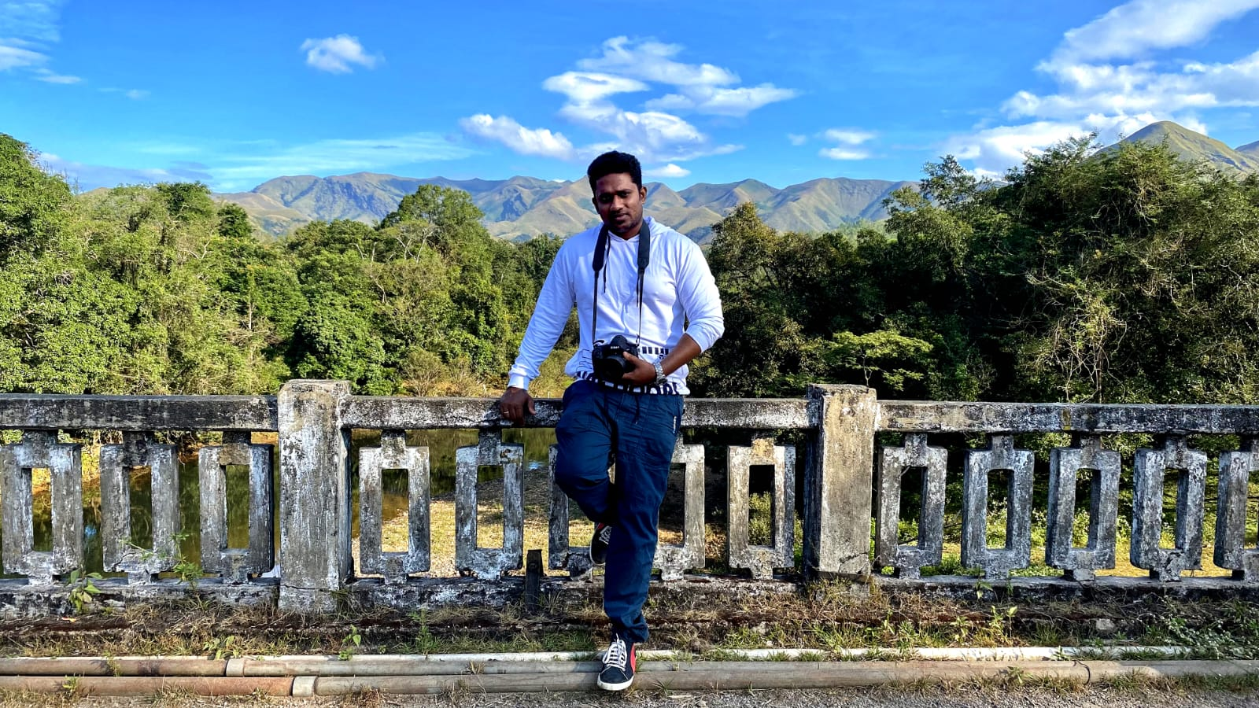
About Me
Personal Details
  From Bangalore, India
  Love Travelling, Trekking and Exploring new places
  Wildlife and Nature Photography Enthusiastic
Education Background
  Bachelor of Engineering in Computer Science
Work Details
  7+Years of Work Experience on Mifos X/Fineract
  Roles played over the years:
    Support Engineer, Developer, Data Analyst, Implementation head, Project Lead, Business Analyst, Product Owner
Bharath Gowda
Lead Implementation Analyst- Mifos

Slide 4
Why do we need a roadmap?
Growing footprint of Fineract and Mifos
  Coordination of requirements & direction of platform is needed
    Large number of users & adopters
    Constantly growing variety of use cases that can be supported.
    Large set of functional and non-functional enhancements
    Diverse set of contributors & participants to steward.
Mifos’ role
  Convene stakeholders from integrators and adopters to a common vision/direction

Slide 5
What will the roadmap accomplish?
Signal what's coming
  More likelihood of big entities adopting if they know what’s coming
  No motivation to upgrade without visibility into forthcoming releases.
  No fear of missing out (FOMO) if they don’t know what contributions are coming.
Signal what’s needed
  What and how others can pick up and contribute
  Avoid multiple organizations working on same feature
  Increase in visibility & encouragement for adopting & contributing to Fineract
Community-driven requirements gathering
  Better means of community having a voice and express into what goes in

Slide 6
Goals for Today’s Session
What it’s not
  Definitive final version of roadmap
  Plan for how paid feature development happens.
What it is:
  Start conversation on what needs to be achieved
  Define framework on how to track contributions via a roadmap
  Propose processes on publishing a roadmap
  Get feedback on the process
  Begin to execute on the process

Slide 7
Roadmap Legend
Category | Description | Level of Confidence to Ship/Build
Committed Efforts | Funded by customers, grants, or partners. Development that is already in progress with tasks assigned to developers. | > 90%
Pledged Contributions | Upstream contributions pledged by partners | > 50%
Planned Contributions | Prioritized features & enhancements that are awaiting an assigned contributor. | > 10%
Ideas | Unprioritized ideas and feature requests. | >5%
Notes:
Pledged efforts

Slide 8
Committed Efforts
PEPPER SOUP
FUNCTIONAL
1.Delinquency Enhancements
-Delinquency Bucket classification at loan product level
-Delinquency allocation at loan account level
-Delinquency history
2.Transactions Enhancements
New Transactions have been introduced to support BNPL product use cases
- Refund transaction
- Chargeback transaction
- Goodwill credit
- Credit Balance Refund transactions
3.Loan Account level Enhancements
- Multi Disbursement Scenarios without Tranche Additions
- Approved and Disbursement amount changes
- Schedule Enhancements with N+1 scenarios
- Charge-off Scenarios
4. Admin Level Changes
- Datatables extensions to product level
Non-Functional
1. Postgres Support
2. Idempotency
3. Graceful shutdown
4. Business Date Introduction
5. Business&Reliable Events framework
GEDIT FINANCE
FUNCTIONAL
1. Reschedule with overdue charges
2. Bulk Waive of charges
3. Future date pre-closure
4. Loan-level overdue charges (x2)
5. Tax on interest
UPDRAFT
Loan reschedule feature enhancements
Fixing loan repayment complex scenario issue
  Ex: interest recalculation+reschedule scenarios
CREDILINQ
Charge product Improvements
Invoice discounting product achievements
SAFARICOM
Overdraft enhancements
Notes:
Pepper soup: BNPL products in US, gefit finance- unsecured business loans from philippines
Updraft: credit facilities around UK, Credilinq - provide credits around singapore region
Doing in coordination with fintecheando and fynrafyn and alluvial and DPC
Idempotency method means that the result of a successful performed request is independent of the number of times it is executed.
An operation that produces the same results no matter how many times it is performed.

Slide 9
Pledged Contributions
Pepper Soup
  Capitalized fees
  Charge-off functionality
  Transaction wise Repayment strategy- at transaction wise
Fiter
  …
VGG
  Accrual accounting for savings module
  Fixed Deposit changes
Open factor
  KYC Risk Assessment
  Teller Cashier full module
  Loan Limit based on client Profile rating
Idea Holic
  KYC Risk Assessment
  Teller vas
EMERyTE
  Savings Module Enhancements
-Withdrawal limits per day
-Fingerprint authentication for withdrawals
Notes:
Fiter:- global., Pepper soup:- BNPL in US. VGG:- From Nigeria. Open factor technologies: in South africa
IdeaHolic:-from India Emeryte:- Ivory coast
Tracking customized features through roadmap/antiroadmap process

Slide 10
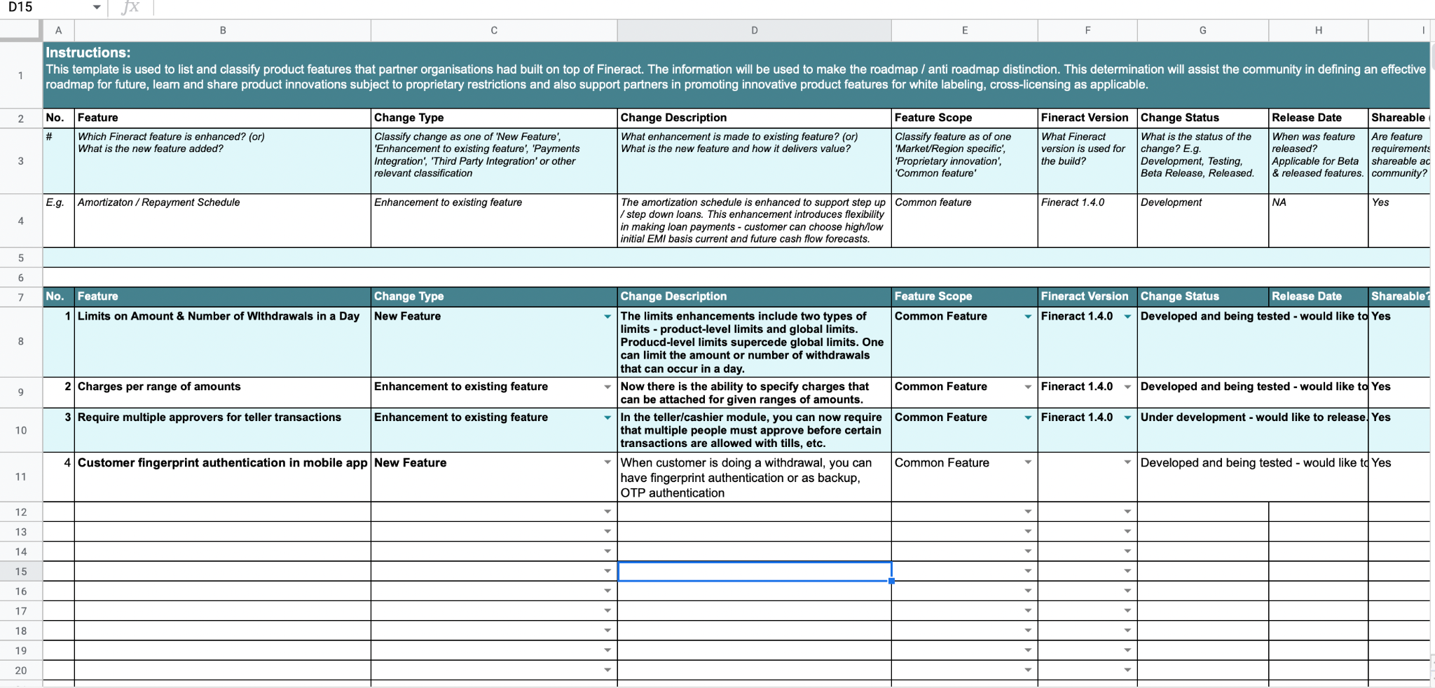

Slide 11
Pledged Contributions
Partner XYZ
  New feature 1
  Integration 1
….
…
Customer ABC
  New feature 1
  New feature 2
….
….

Slide 12
High Priority Planned Contributions
Functional
  Asset management
  Treasury management
  Savings Group functionality
  Client Deceased process and Insurance module
  Client Rating and blacklisting feature with Loan Limit adjustments
  Line of Credit
  Savings module enhancement
  EOD and EOY process for Accounting
  Invoice factoring
  Supply chain financing
  Leasing
  Payments and wallets Features
  Cross-Currency Exchange
  Workflows/rules engine
Non functional
  Lombok
    To reduce the boiler plate
  Introduce type safety in REST layer ("api")
  Automatic source code migration tool
  Scalability of Savings Module
  Secure self-service API layer
Integration Roadmap
  Improve SMS and Email integration for better notification purposes
  KYC
  Fraud and Risk management integration
  Card Management
Notes:
Right now down informally or individually , but now we will have process to streamline into upsteam
Trying to have architectural working groups to discussion around non-functional requirements, who have strong opinions n visions on improvements
All priority collected here will are planned through formal meetings RFC and triage community sessions as
—--
Cash management refers to a broad area of finance involving the collection, handling, and usage of cash. It involves assessing market liquidity, cash flow, and investments.
—-
Asset management is the practice of increasing total wealth over time by acquiring, maintaining, and trading investments that have the potential to grow

Slide 13
Summary of Completed Efforts
PEPPER SOUP
FUNCTIONAL
1.Delinquency Enhancements
-Delinquency Bucket classification at loan product level
-Delinquency allocation at loan account level
2.Transactions Enhancements
New Transactions have been introduced to support BNPL product use cases
- Refund transaction
- Goodwill credit
- Credit Balance Refund transactions
3.Loan Account level Enhancements
- Multi Disbursement Scenarios without Tranche Additions
- Approved and Disbursement amount changes
- Schedule Enhancements to support N+1 Scenarios
- Business&Reliable Events framework
5. Webapp UI for supporting Fineract API
Non-Functional
1. Postgres Support/Eclipse link
2. Business Date Introduction
GEDIT FINANCE
FUNCTIONAL
1. Reschedule with overdue charges
2. Bulk waive of charges
UPDRAFT
Loan reschedule feature enhancements
Fixing loan repayment complex scenario issue
  Ex: interest recalculation+reschedule scenarios
VGG
Accrual accounting for savings module
Fixed Deposit changes

Slide 14
Making Planned Contributions a Reality
Scoring and prioritising the Planned Stories
Interested
Sponsored through granting entities, partners and/or paying customers
Through internship programs & volunteers to improve professional resume
Adding bounty to the tasks where interested freelancers could work
Upstream
Notes:
Put in more detail of where we expected planned contribution resources to be coming from
Partners
Interns
Volunteers
Strategic Partners
Granting Entities

Slide 15
2022 - 2023
Roadmap Demo

Slide 16
Roadmap Timeframe & Sections
Sections & Categorizations
Core/Non-Core
Functional/Non-Functional
Ilities - deployability, scalability, reliability
Prioritization Metrics
Business/Community/Strategic Drivers.
Definition of Ready
Voice & Express Freedom
  Feedback section
  New Idea submission section
Other Aspects of the roadmap
  Documentation
  Testing
Timeframe of Roadmap
High-level Process from Idea to Reality
Living Roadmap - continues to evolve
6 Months
Q1
Q2
Notes:
One release each Q

Slide 17
Q4 2022
PEPPER SOUP
FUNCTIONAL
1.Transactions Enhancements
New Transactions have been introduced to support BNPL product use cases
- Chargeback transaction
- Goodwill credit transactions
Non-Functional
Idempotency
Events framework
Business date functionality
GEDIT FINANCE
FUNCTIONAL
1. Reschedule with overdue charges
2. Bulk Waive of charges
Pepper Soup
Capitalized fees
Charge-off functionality
VGG
Accrual accounting for savings module
Planned Contribution
Non functional
  Lombok

Slide 18
Q1 2023
PEPPER SOUP
FUNCTIONAL
1.Delinquency Enhancements
-Delinquency history
2 Admin Level Changes
- Datatables extensions to product level
NON FUNCTIONAL
1. Graceful shutdown
2. Spring Batch Framework
Pepper Soup
Transaction wise Repayment strategy- at transaction wise
Open factor
KYC Risk Assessment
Planned Contribution
Notes:
Spring batch helps to break a huge chunk of items to be processed into multiple small portions and run them parallelly

Slide 19

2022-2023 Roadmap Highlights
Notes:
https://mifos.airfocus.com/share/c53b6a6d0f1609c301ede71115d53e40

Slide 20
Processes
To make Roadmap work!

Slide 21
How Ideas formally enter the roadmap?
Collect Ideas
  Submit the Idea through the roadmap portal
    https://mifos.airfocus.com/share/c53b6a6d0f1609c301ede71115d53e40?item=41cf5120-764f-4f03-b377-5ed8d1fca758
  Tickets opened as feature request/Improvements in JIRA
Triage & Prioritize Ideas (bi-weekly community triage meeting to review)
Gather interest & refine ideas with high priority and need
  Discuss ideas on the mailing list
  Request for Comments (RFC) process
  Program Increment Meetings (Virtual and Physical)
Topics
Flush out detailed requirements
Discuss architecture and engineering way for making it generic and easy compatibility
Scoring Prioritizing based on the interest
Moving to Development in committed or pledger or planned form.
Notes:
Discuss on List
Create a ticket on Jira
Submit an idea through this tool
AT what point does item go from roadmap tool to JIRA - what is cut off?
Discussion and Gathering Interest around the Idea from the community and refining the requirements around the Idea
RFC process
PI meetings
Virtual gathering
Topics to discuss
Flush out detailed requirements
Discuss architecture and engineering way for making it generic and easy compatibility
Scoring. Prioritizing based on the interest
Moving to Development in committed or pledger or planned form.
Bi-Weekly community triage meeting to review ideas

Slide 22
Pledge a Contribution to the Roadmap?
Share and express intent for pledging contributions
  Fill out roadmap/anti-roadmap document.
  Create a ticket on JIRA
Document functional requirements
Discuss design and get feedback on mailing list
Assign a target release
…Standard development & contribution workflow.

Slide 23
Assign & Take Ownership of Planned Roadmap Item
Assign in JIRA
Allocate and communicate which resource will be working on assigned item.
Finalise requirements and designs of enhancements
Discuss timeline of implementing with community
Coordinate with release manager to schedule into release plan
…Standard development and contribution workflow.

Slide 24
Sponsor or Fund Development of a Roadmap Item
Communicate
Be deliberate about why customers should contribute all enhancements upstream. Communicate items that could use funding
Crowd-fund development of features.
Contact a partner
Comment on the ticket or roadmap item.
Work with a partner to implement and ensure that contribution goes upstream
Bounty program?

Slide 25
Roadmap & JIRA & Release Management
Associate target releases with quarterly roadmaps?
At what point does a roadmap ticket go into JIRA?
At what point do we assign a roadmap item to a release

Slide 26
Definition of Done
Test cases and Acceptance Criteria
Documentation Work
Functional & Use cases
Development Work
Roadmap - fineract ticket, acceptance criteria, test, documentation, tests.
Fineract Ticket for the Idea on Roadmap
QA Completion
Update User manual and the community list
Notes:
Once the features comes out of roadmap to release section, these are definition of dane on having the feature being implemented in the defined process

Slide 27
Call to Action & Next Steps
Get feedback on tools & processes proposed today
Continue collecting ideas and requirements
  Publish idea portal & launch roadmap tool
  Encourage partners to actively update roadmap/anti-roadmap documents
  Continue requirements gathering and partners looking to contribute
  Kick off triage and circulate RFCs
Refine and continuously evolve roadmap - webinar every 6 months
  Establish roadmap for documentation and testing strategy
Synchronize roadmap tool with JIRA and Release Processes
  Get community input on handling Bugs, Improvements & Hotfix releases in most efficient way
Get partners and volunteers to start contributing upstream!

