Slide 1
Real time Payments in Mexico using Apache Fineract

Slide 2
Agenda
Introduction
Alberto Hernández / Me
About Us
Building Blocks
Apache Fineract
Fineract CN
Mifos Payment Hub Enterprise Edition
CoDi
P2P
B2C
Solution
Challenges
Our requirements
Time to Market
Project Management
Technical constraints
Risk and Compliance
Apache Fineract + Mifos PHEE + CoDi
Questions and Answers
Contact

Slide 3
Introduce Myself

Slide 4
Alberto Hernández / Me
I have more than two decades of experience in the Information Technology area, mainly in financial services. I like to drive innovation by creating tech solutions within the Apache Fineract and Mifos ecosystem.
I have been using Apache Fineract and Mifos Payment Hub Enterprise Edition to bring high availability and reliable solutions for different financial entity types, like Banks, Investment Societies and Fintechs.
I have successfully overcome challenges related to aligning Open Source Technologies to the regulatory rules to strike a balance between innovation and compliance.
Our last reached goal was the certification of the Apache Fineract and the Mifos Payment Hub Enterprise Edition as a Contactless Payment Solution for the Real Time Payment Network with the Mexican Central Bank which is CoDi® for merchants.
I love spending time outdoors with my family and puppy, Toto.

Slide 5
About / Us
FINTECHeando is a Mexican company which develops software and our target are customers focused in the financial inclusion. Our culture is based on transparency, respect, open communication, feedback, collaboration with our customers, employees and partners. Our success is the result of the value generated to our customers. The pillars of our stack are the Apache Fineract and the Mifos Ecosystem which can be used as independent modules or as an E2E (end to end) financial solution.

Slide 6
Apache Fineract
Apache Fineract is the modular open source software for solving financial requirements of cooperatives, investment societies, fintechs, neobanks, banks, ecommerces and governments.
In our experience we have used it as a cost effective, time efficient and scalable solution for solving any challenge, either from the operational requirements or even the complex accounting rules of any Financial Institution.
For the end customers of the financial institutions they got access to financial inclusion which can help them to solve their financial stress and allowing the financial mobility.

Slide 7
Building Blocks

Slide 8
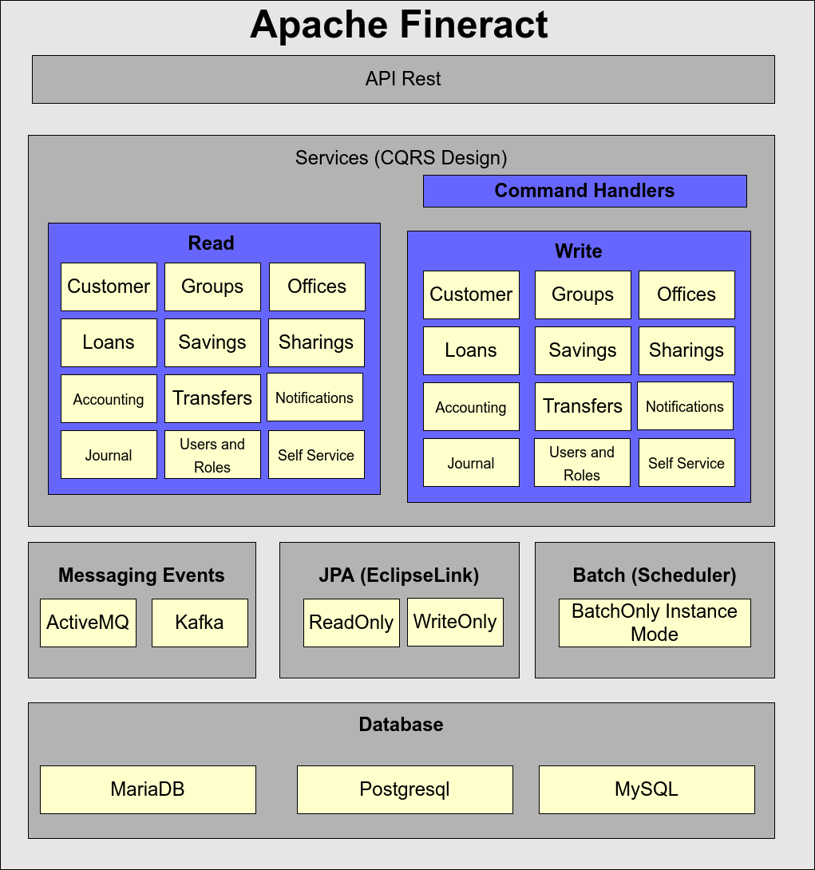
Architecture Apache Fineract

Slide 9
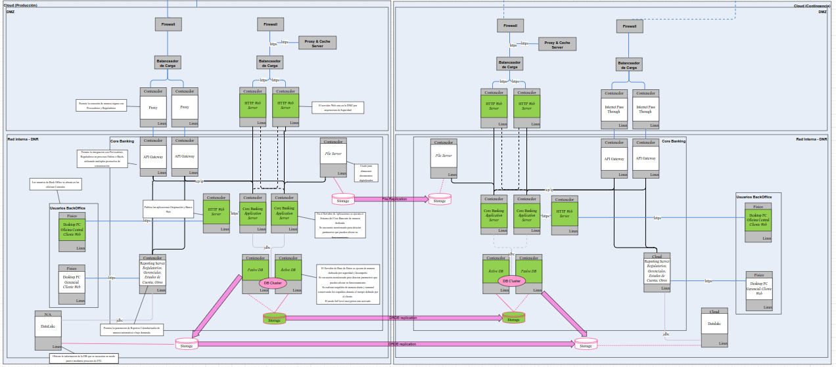
HA Architecture Apache Fineract

Slide 10
Apache Fineract CN
Apache Fineract CN is a microservice software designed to encapsulate financial domains for integrating and orchestrating complex business rules which are required by medium or large institutions.
In our experience we have used it as a replacement of legacy core banking solutions running in Mainframe or Midrange platforms, it has been chosen by the transaction per second and API Rest integration capacities.

Slide 11
Mifos Payment Hub EE
Mifos Payment Hub is the component which connects Digital Financial Service Providers to Payment Networks. In our case, it connects Fineract 1.x and Fineract CN to SPEI® (Interbank Electronic Payment System) using CoDi® APIs. The SPEI® Network and CoDi® APIs are managed by the Mexican Central Bank (BANXICO. The Mifos Payment Hub communicates with these Fineract versions via REST APIs. To support the calls and actions our deployment has taken the out of the box versions of Fineract/Fineract CN. The main ingredient (secret sauce) for this connection are the HTTP connectors orchestrated by Camunda (BPM).

Slide 12
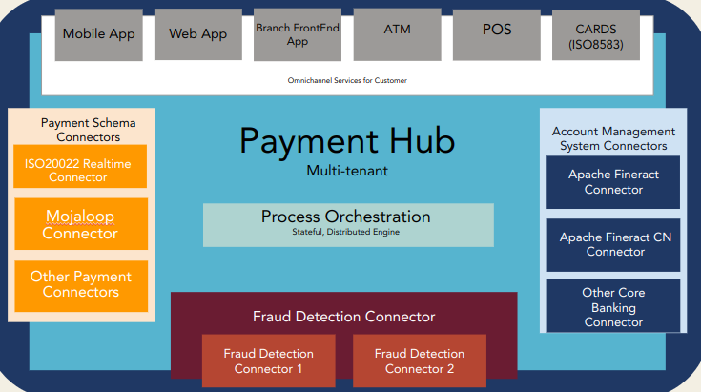
Mifos Payment Hub EE

Slide 13
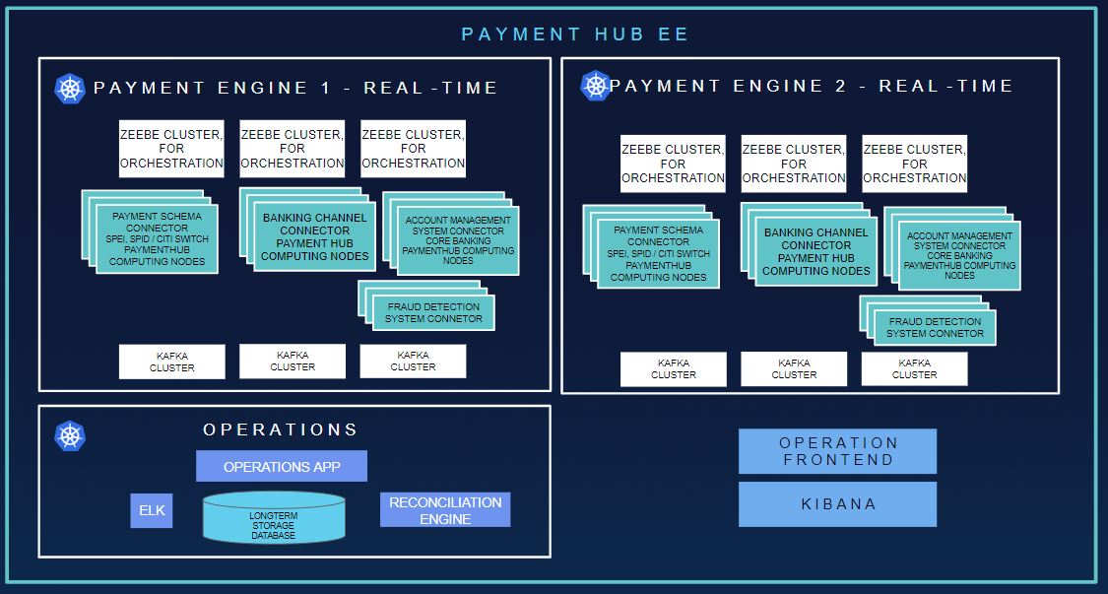
HA Architecture - Mifos Payment Hub EE

Slide 14
Solution

Slide 15
Challenges
Process to be participant (Banxico certification)
Our requirements
Time to Market
Project Management
Technical constraints
Risk and Compliance
Reference: https://www.banxico.org.mx/sistemas-de-pago/codi-cobro-digital-banco-me.html
Notes:
Complete the whole project in less than 6 months
QR generation
Push Message sending
Query the Transaction Status
Receive the Transaction Status
Create a test plan based on the specification requirements
Self funding project
Project Management for giving the project status to the Central Bank

Slide 16
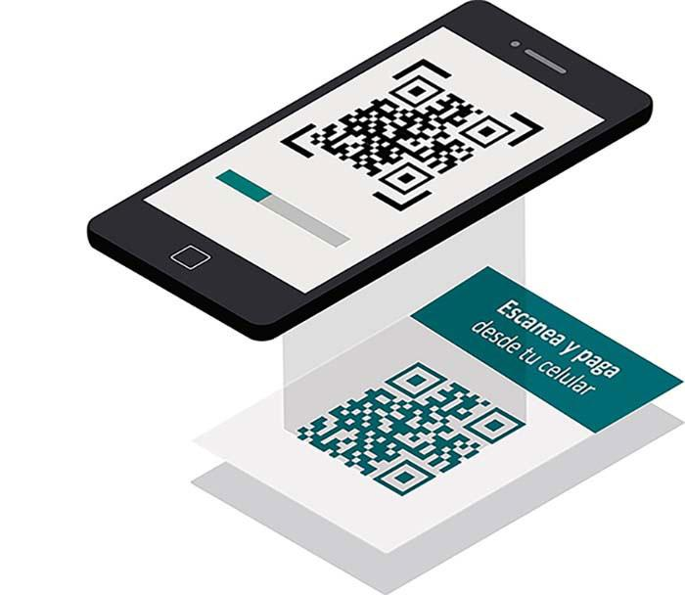
CoDi®
CoDi® is a software platform developed by the Mexican Central Bank (BANXICO) which is used for digital payments in real time using QR and NFC over the existing SPEI® infrastructure which is the Interbank payments platform also developed by BANXICO using P2P connections.
Banks and now FINTECHs are participants and BANXICO is the hub or coordinator
Reference: https://www.banxico.org.mx/sistemas-de-pago/codi-cobro-digital-banco-me.html

Slide 17
CoDi® requirements
Simple enrollment process
Transactions must be reflected in real time
Free / No fees
NFR
Availability 24/7 - 365 days
Speed / Time response in less than 5 seconds
High availability and resilience
Process to be participant (Banxico certification)
Reference: https://www.banxico.org.mx/sistemas-de-pago/codi-cobro-digital-banco-me.html

Slide 18
How CoDi® works?
Using QR technology (Quick Response, for its acronym in English) the operation data is stored within a square, which allows us to store a large amount of information, then be read and displayed from an mobile application. This code can be static in an establishment or it can be generated in each transaction.
NFC (Near Field Communication) technology is based on the transmission of data and information, simply by bringing two mobile devices closer to each other.
Reference: https://www.banxico.org.mx/sistemas-de-pago/codi-cobro-digital-banco-me.html

Slide 19
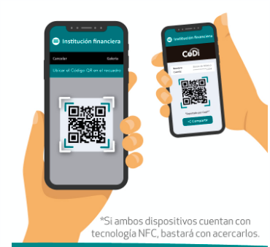
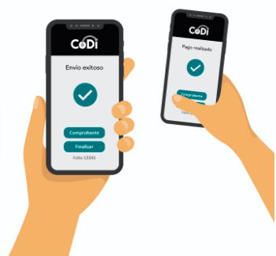
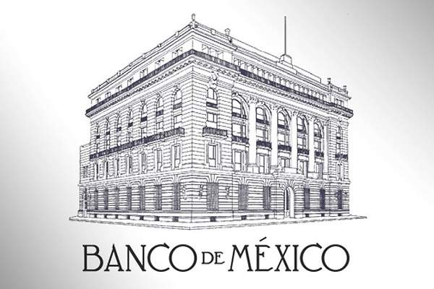
CoDi® - P2P
Payment Request Creation
Payment Request Reception
Reads and decrypt the QR code for Accepting or Rejecting the Payment Request
QR code is created and encrypted. The message is sent to the destination.
Apache Fineract (AMS)
Apache Fineract (AMS)
Central Bank ACK the TXs
Financial Institution A
Financial Institution B
Mifos Payment Hub EE
(Payment Switch)
Mifos Payment Hub EE
(Payment Switch)
Payment Request/Settlement/Aceptance Messages are sent by the CoDi Infrastructure
CoDi and SPEI are trademarks of Banco de México

Slide 20
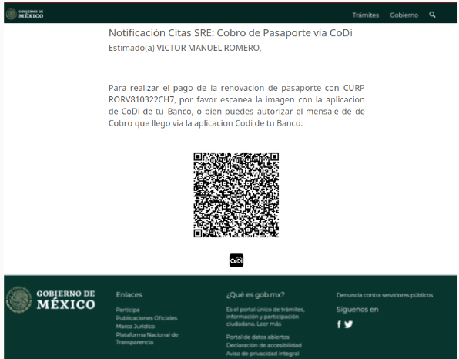
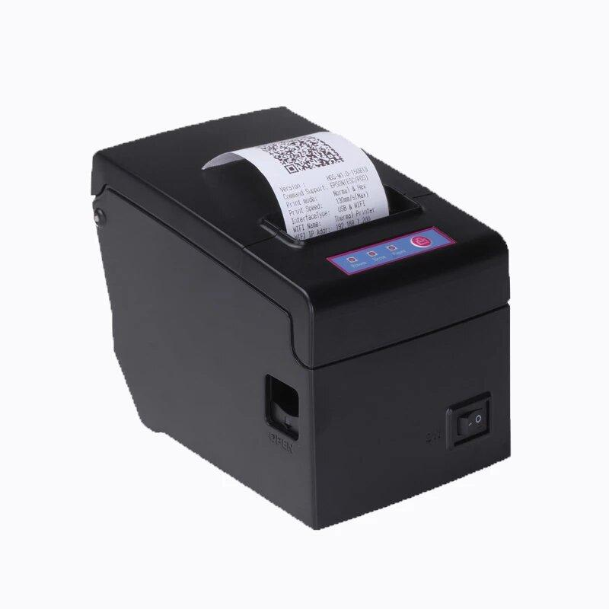
CoDi® - B2C
Payment Request Creation
Payment Request Reception
QR code is created and encrypted. The message is sent to the destination On Demand or Scheduled.
The Smartphone, the Printed Ticket, e-Mail or Web Page are now the PoS in real time and no extra fee over the service/product price.
Reads and decrypt the QR code for Accepting or Rejecting the Payment Request
Apache Fineract (AMS)
Central Bank ACK the TXs
Apache Fineract (AMS)
Financial Institution A
Financial Institution B
Mifos Payment Hub EE
(Payment Switch)
Mifos Payment Hub EE
(Payment Switch)
Payment Request/Settlement/Aceptance Messages are sent by the CoDi Infrastructure
CoDi and SPEI are trademarks of Banco de México

Slide 21
CoDi® benefits
Costs are reduced due no fees and no relocation expenses
Agile Transactions
More secure reducing risks like cash management, cash cloning, frauds
Promotes financial inclusion to be easy to implement and use for micro/small businesses, merchants and general public
Banxico issues an electronic receipt (CEP) and It can be traceable
Reference: https://www.banxico.org.mx/sistemas-de-pago/codi-cobro-digital-banco-me.html

Slide 22
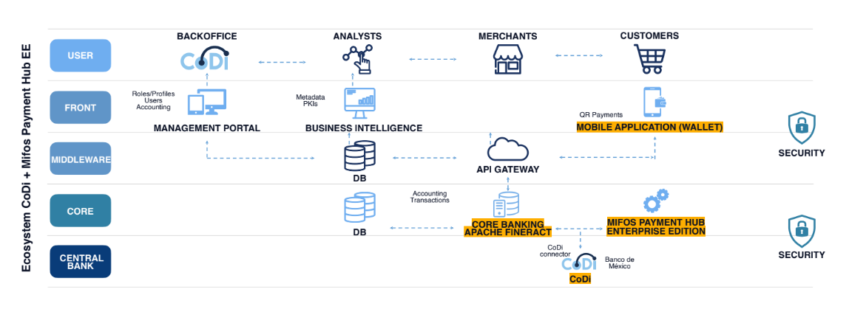
Apache Fineract + Payment Hub Enterprise Edition + CoDi®

Slide 23
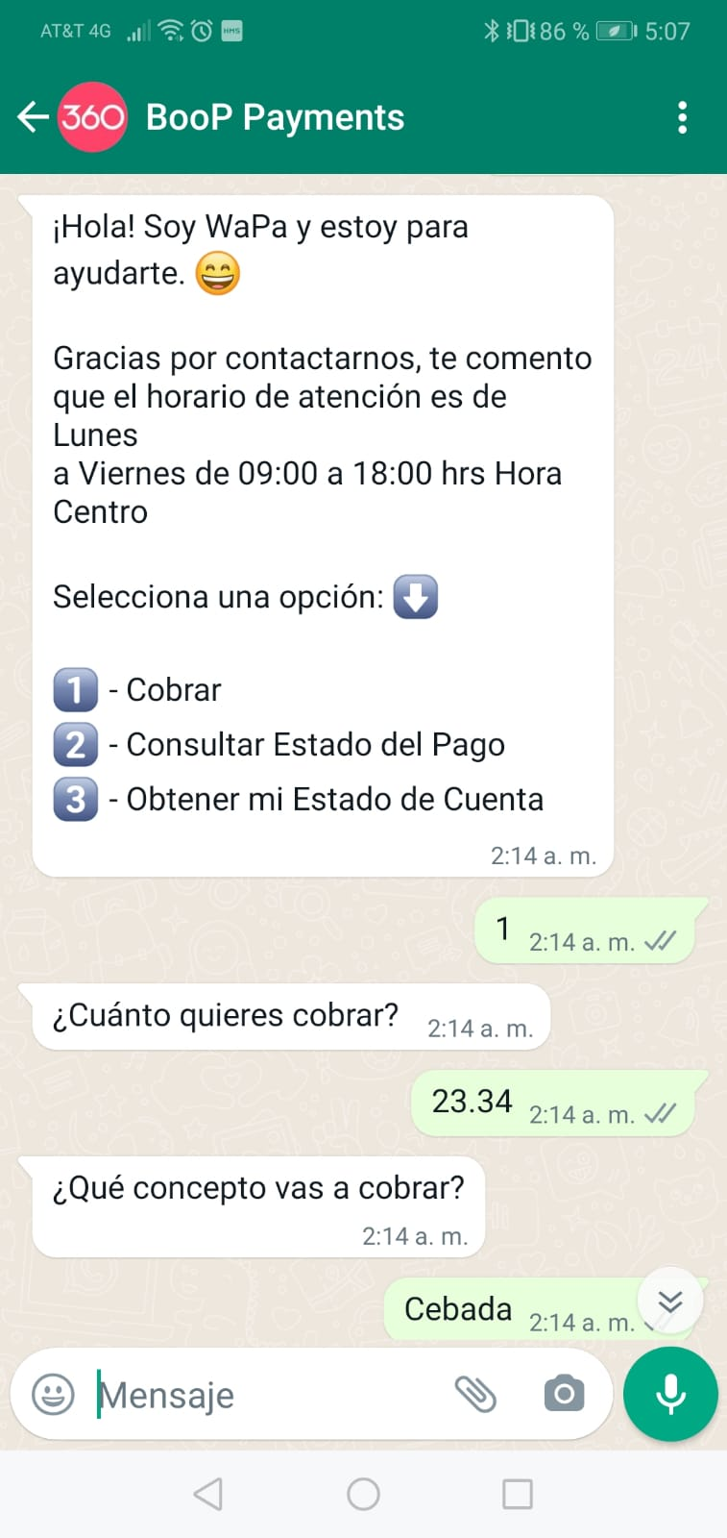
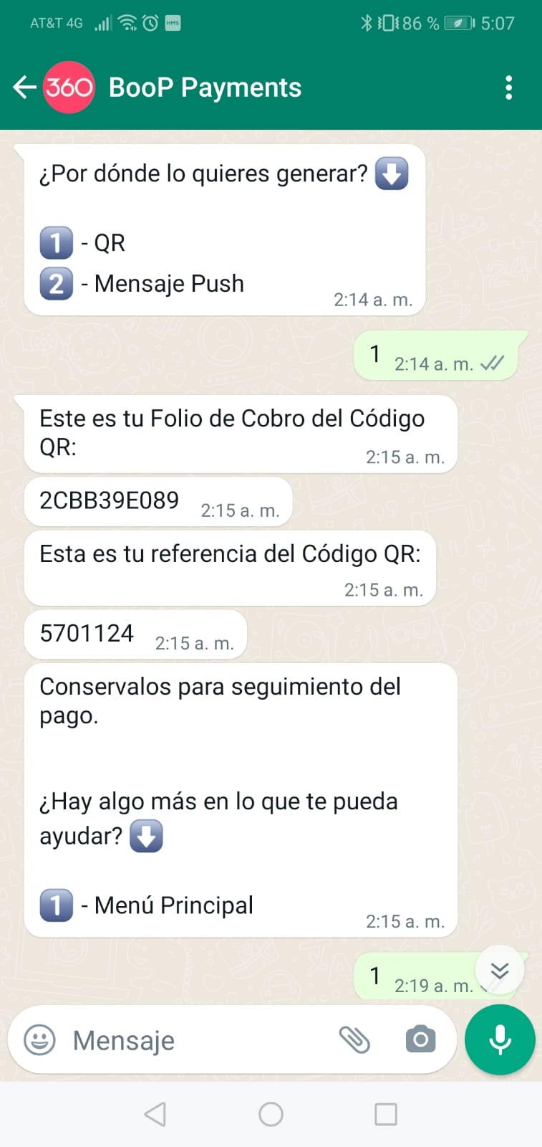
QR Payment request by WhatsApp

Slide 24
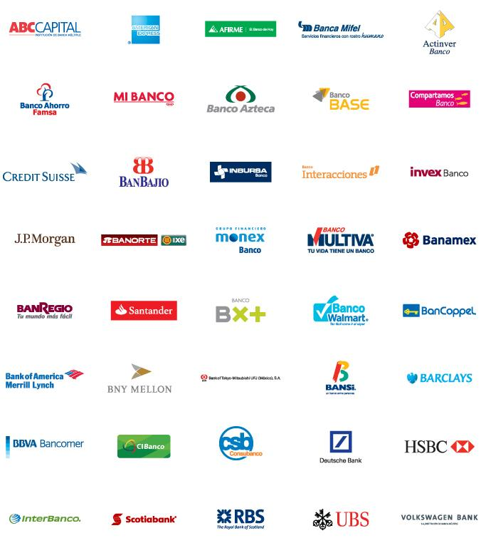
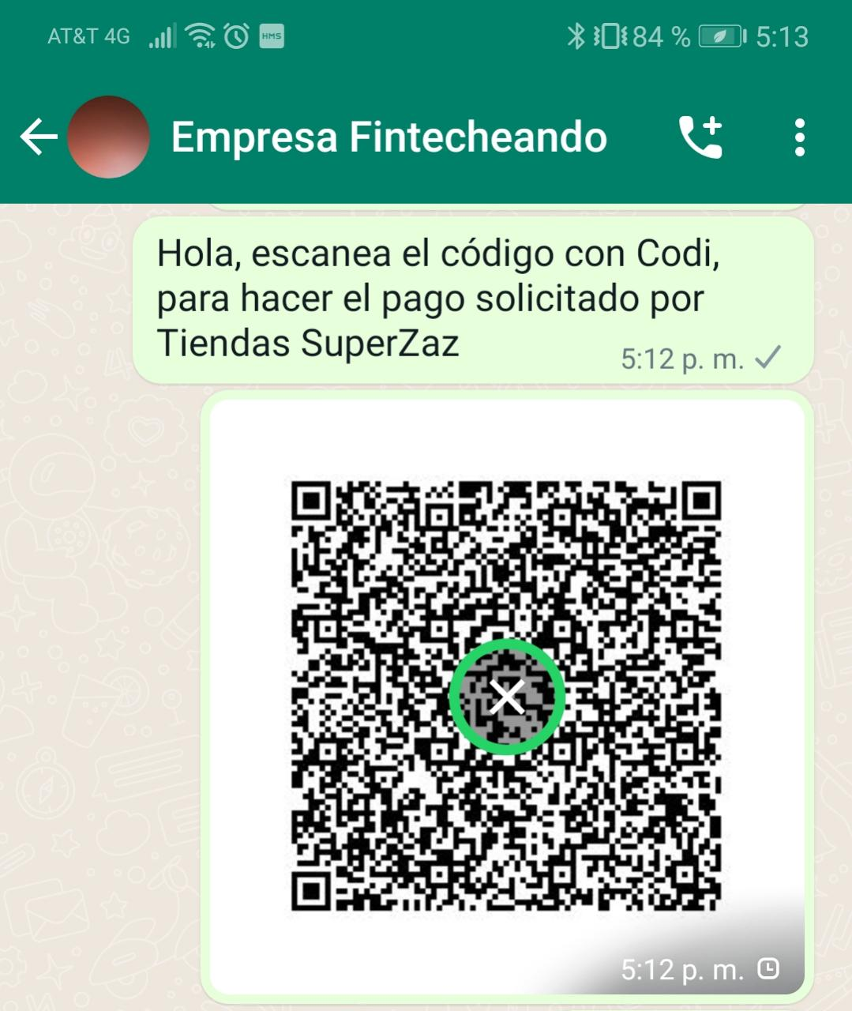
QR Payment received by WhatsApp and pay with CoDi®
Scan & Pay

Slide 25
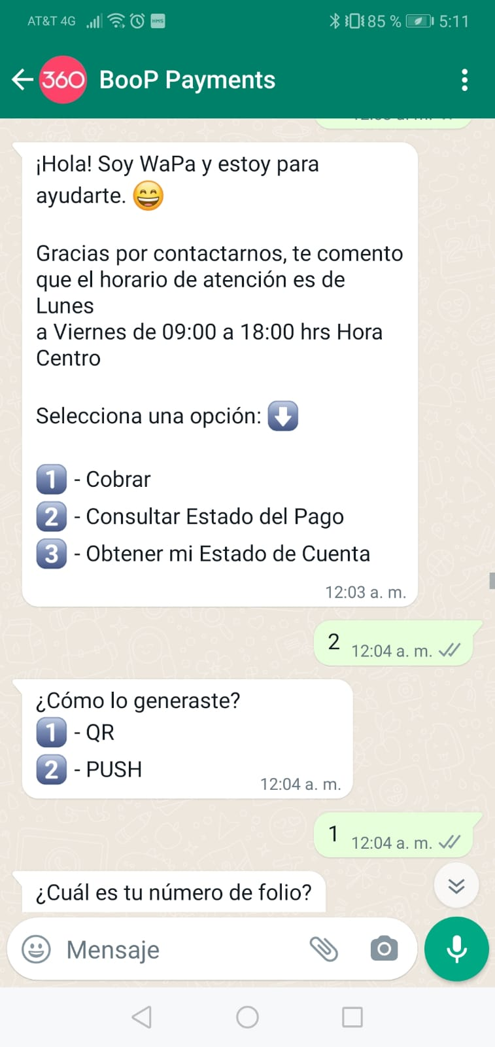
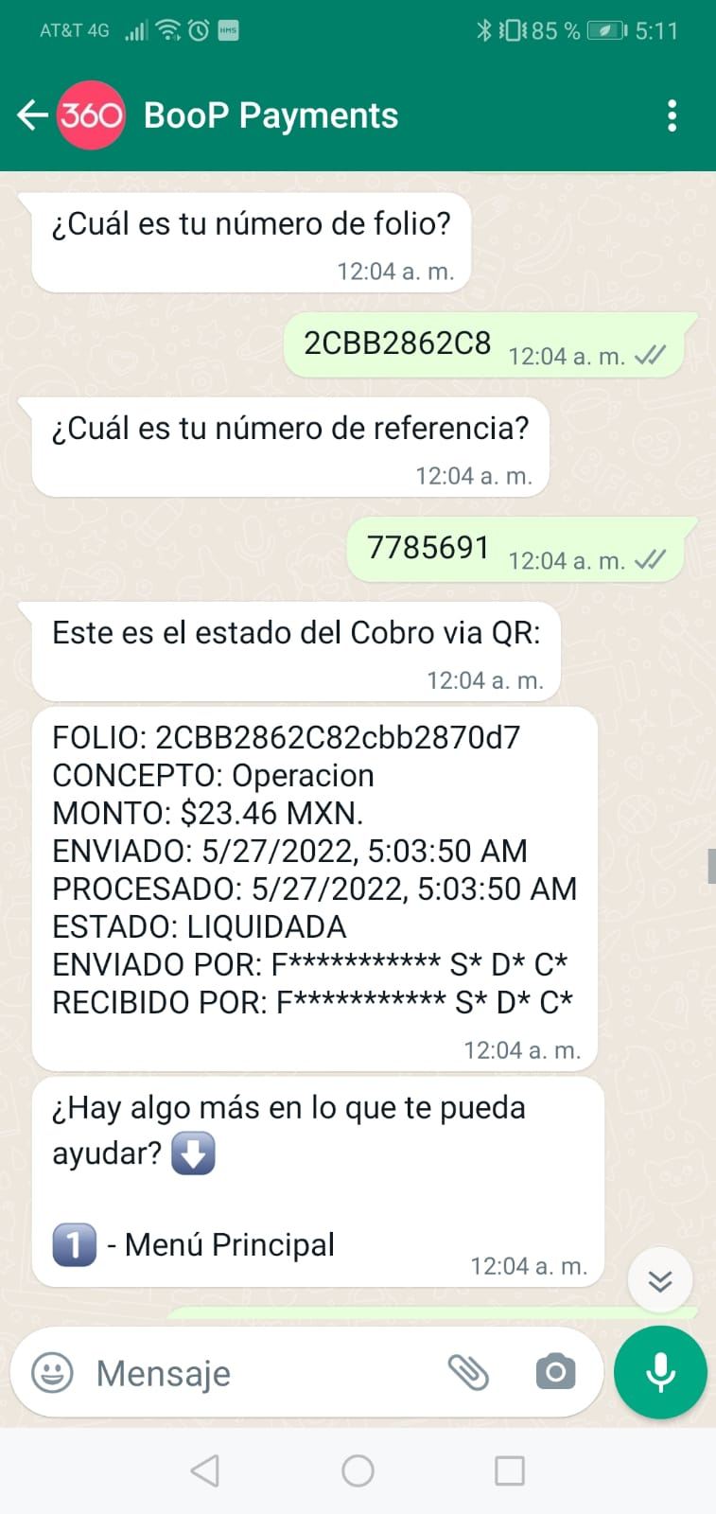
QR Payment status using WhatsApp

Slide 26
Questions & Answers

Slide 27
Contact
Apache Fineract
https://fineract.apache.org
Mifos
https://mifos.org
Fintecheando
https://fintecheando.mx
Alberto Hernández
alberto.hernandez@fintecheando.mx

